Slide 1



Who We Are
A leading international Learned Society
  Industry and academia
  All fields of magnetics
Aims
  promote knowledge transfer between industry, academia and government
  initiate active collaboration amongst its members
  provide services of benefit to its members
Members
  Academics
  Companies
  Industrialists
  Government
  Retired professionals
  Students
  University research groups
  Anyone interested in magnetics
(There are no geographical restrictions on membership)

Slide 2
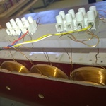
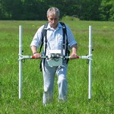
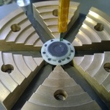
Who We Are
70% UK Based
30% Global

Slide 3




























Notes:
E

Slide 4
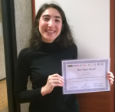


What We Offer
General Benefits
Seminars
Networking opportunities
MagNews
Technology Brokerage and Technical Enquiries
Publicising magnetics
Website
Vacancy / Job Listing
Focussed advertising
Member Benefits
Reduced seminar rates for members
Reduced advertising rates for website and MagNews
Free recruitment advertising for website and MagNews
Access to past seminar papers
Listing in Technical Directory of Members’ Services
Support for students to attend conferences

Slide 5

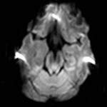
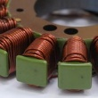
Student Bursaries
For Undergrad and Postgrad students
£300 to attend UK events
£500 to attend international events
Bursaries to support students at member universities attending conferences and exhibitions worldwide
Simple application process
Does not include UK Magnetics Society events

Slide 6
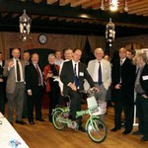
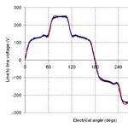
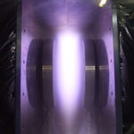
Use Us To
Publish your paper
Promote your conference, seminar or exhibition
Create collaborations for new projects across the whole of magnetics
Advertise your products, group, company, or yourself
Find conferences or exhibitions to attend
Fill a vacancy
Publicise your new product, results, idea, or site
Establish connections in industry and academia
Catch up on the latest news and gossip
Build networks
Look for your next job or research position
Research technologies old and new
Learn about the latest theoretical and practical developments
…

Slide 7
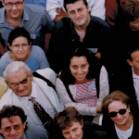
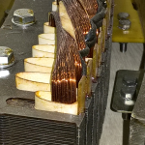

Engage With Us
Become a member – you probably already are but we don’t know you! So…
Sign up – for our eNewsletter at ukmagsoc.org
Let us know – when you leave university, so we can stay in touch
Attend our seminars – join your group members who already do
MagNews – provide content
Volunteer – for the committee, to help run seminars, to speak about your work
Talk to employers – at seminars, on the committee
Tell us – what we could do to help you
…

Slide 8
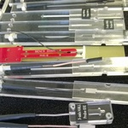
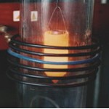
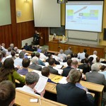
Keep In Contact
w: ukmagsoc.org
e: enquiries@ukmagsoc.org
t: +44 (0) 787 290 8503
tw: @UKMagSoc
l: www.linkedin.com/ukmagneticssociety
f: www.Facebook.com/uk-magnetics-society

